Slide 1

FluxCD – Intro into GitOps

Slide 2
What is GitOps?
GitOps is a way of implementing Continuous Deployment for cloud native applications.
The core idea of GitOps is having a Git repository that always contains declarative descriptions of the infrastructure ( or applications ) currently desired in an environment and an automated process to make the environment match the state descried in the repository.
In the end, this means that in order to deploy a new application or update an existing one you will only need to update the repository and the automated process will handle everything else.

Slide 3
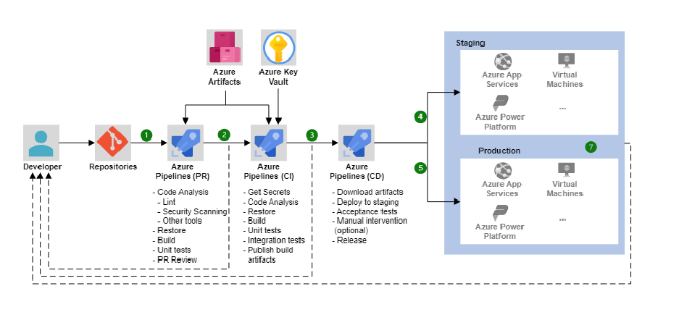
Classic CI/CD Architecture

Slide 4
What is FluxCD?
Flux is a tool for keeping Kubernetes clusters in sync with sources of configuration (like Git repositories and OCI artifacts), and automating updates to configuration when there is new code to deploy.
Flux version 2 ("v2") is built from the ground up to use Kubernetes' API extension system, and to integrate with Prometheus and other core components of the Kubernetes ecosystem
Flux v2 is constructed with the GitOps Toolkit, a set of composable APIs and specialized tools for building Continuous Delivery on top of Kubernetes.

Slide 5
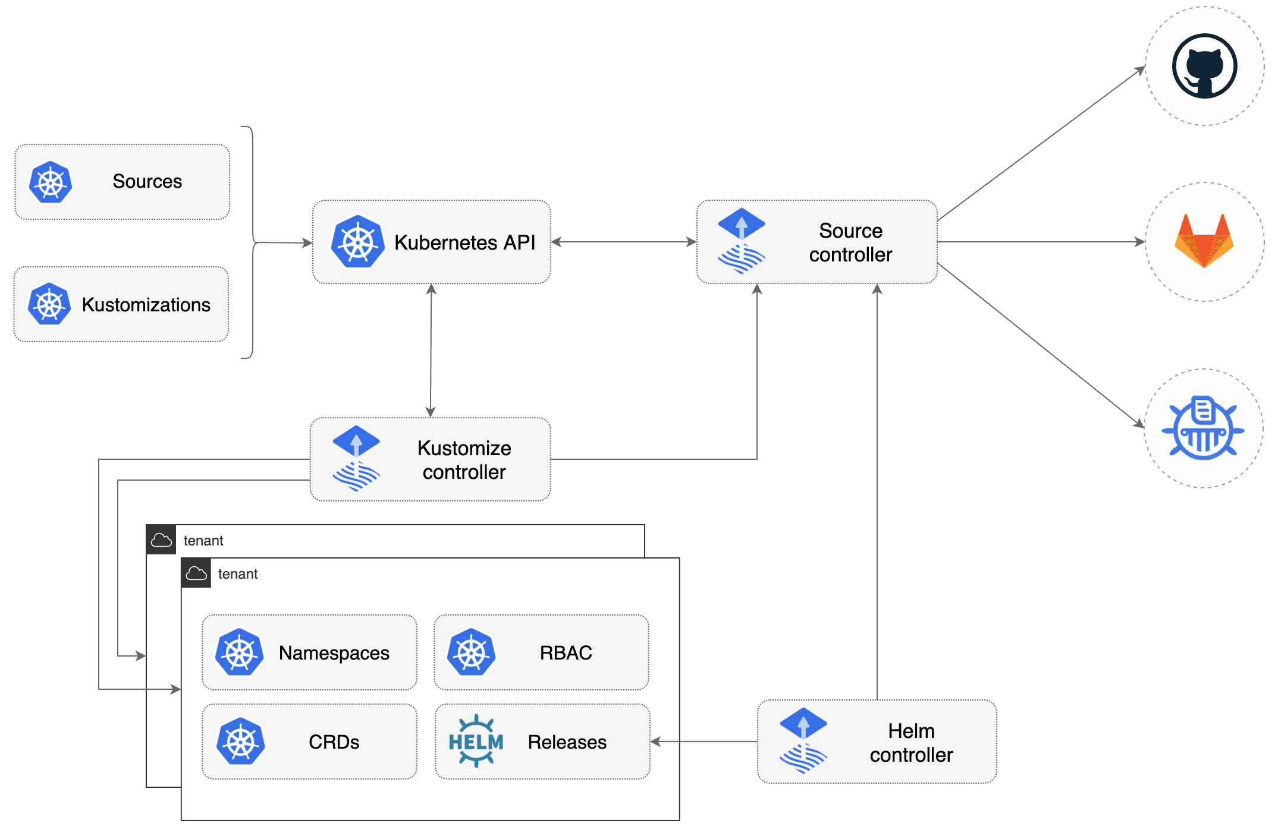
GitOps Toolkit
The GitOps Toolkit is the set of APIs and controllers that make up the runtime for Flux v2.
The APIs comprise Kubernetes custom resources, which can be created and updated by a cluster user, or by other automation tooling

Slide 6
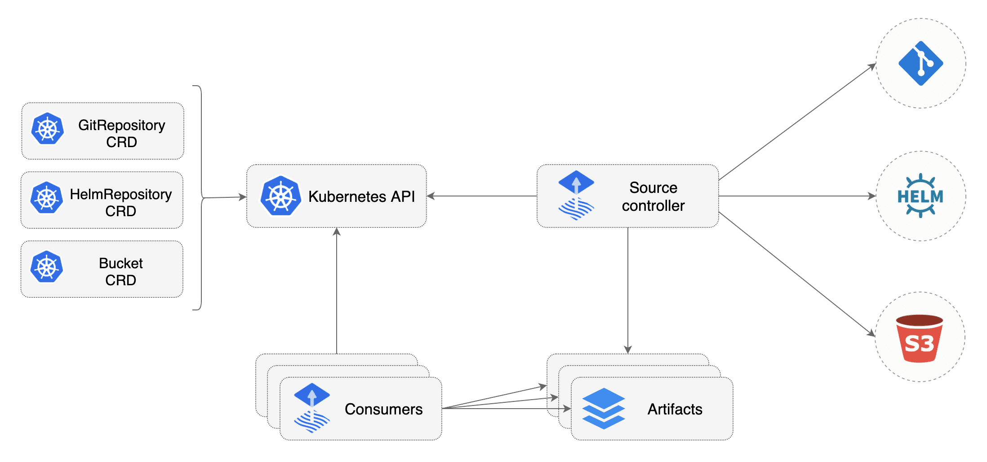
Source Controller
The main role of the source management component is to provide a common interface for artifacts acquisition. The source API defines a set of Kubernetes objects that cluster admins and various automated operators can interact with to offload the Git and Helm repositories operations to a dedicated controller.

Slide 7
Source Controller Features
Validate source definitions
Authenticate to sources (SSH, user/password, API token)
Validate source authenticity (PGP)
Detect source changes based on update policies (semver)
Fetch resources on-demand and on-a-schedule
Package the fetched resources into a well-known format (tar.gz, yaml)
Make the artifacts addressable by their source identifier (sha, version, ts)
Make the artifacts available in-cluster to interested 3rd parties
Notify interested 3rd parties of source changes and availability (status conditions, events, hooks)

Slide 8
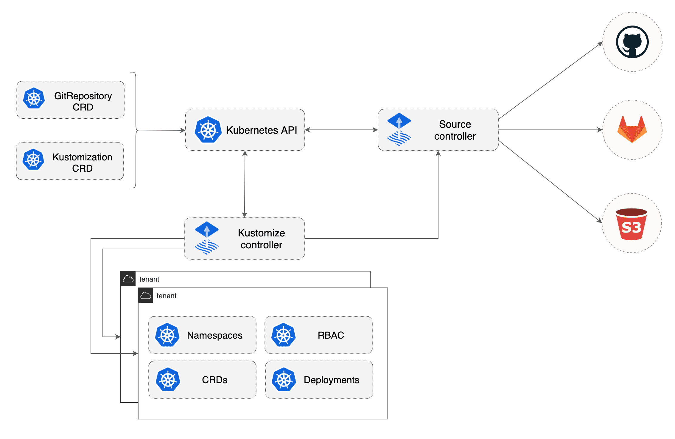
Kustomize Controller
The kustomize-controller is a Kubernetes operator, specialized in running continuous delivery pipelines for infrastructure and workloads defined with Kubernetes manifests and assembled with Kustomize.

Slide 9
Kustomize Controller Features
Reconciles the cluster state from multiple sources (provided by source-controller)
Generates manifests with Kustomize (from plain Kubernetes YAMLs or Kustomize overlays)
Decrypts Kubernetes secrets with Mozilla SOPS and KMS
Validates manifests against Kubernetes API
Impersonates service accounts (multi-tenancy RBAC)
Health assessment of the deployed workloads
Runs pipelines in a specific order (depends-on relationship)
Prunes objects removed from source (garbage collection)
Reports cluster state changes (alerting provided by notification-controller)

Slide 10
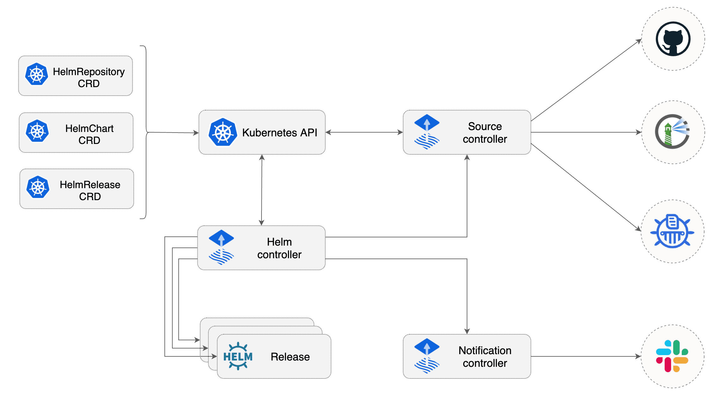
Helm Controller
The Helm Controller is a Kubernetes operator, allowing one to declaratively manage Helm chart releases with Kubernetes manifests.

Slide 11
Helm Controller Features
The desired state of a Helm release is described through a Kubernetes Custom Resource named HelmRelease. Based on the creation, mutation or removal of a HelmRelease resource in the cluster, Helm actions are performed by the controller.
Watches for HelmRelease objects and generates HelmChart objects
Supports HelmChart artifacts produced from HelmRepository and GitRepository sources
Fetches artifacts produced by source-controller from HelmChart objects
Watches HelmChart objects for revision changes (including semver ranges for charts from HelmRepository sources)
Performs automated Helm actions, including Helm tests, rollbacks and uninstalls
Offers extensive configuration options for automated remediation (rollback, uninstall, retry) on failed Helm install, upgrade or test actions
Runs Helm install/upgrade in a specific order, taking into account the depends-on relationship defined in a set of HelmRelease objects
Prunes Helm releases removed from cluster (garbage collection)
Reports Helm releases statuses (alerting provided by notification-controller)
Built-in Kustomize compatible Helm post renderer, providing support for strategic merge, JSON 6902 and images patches

Slide 12
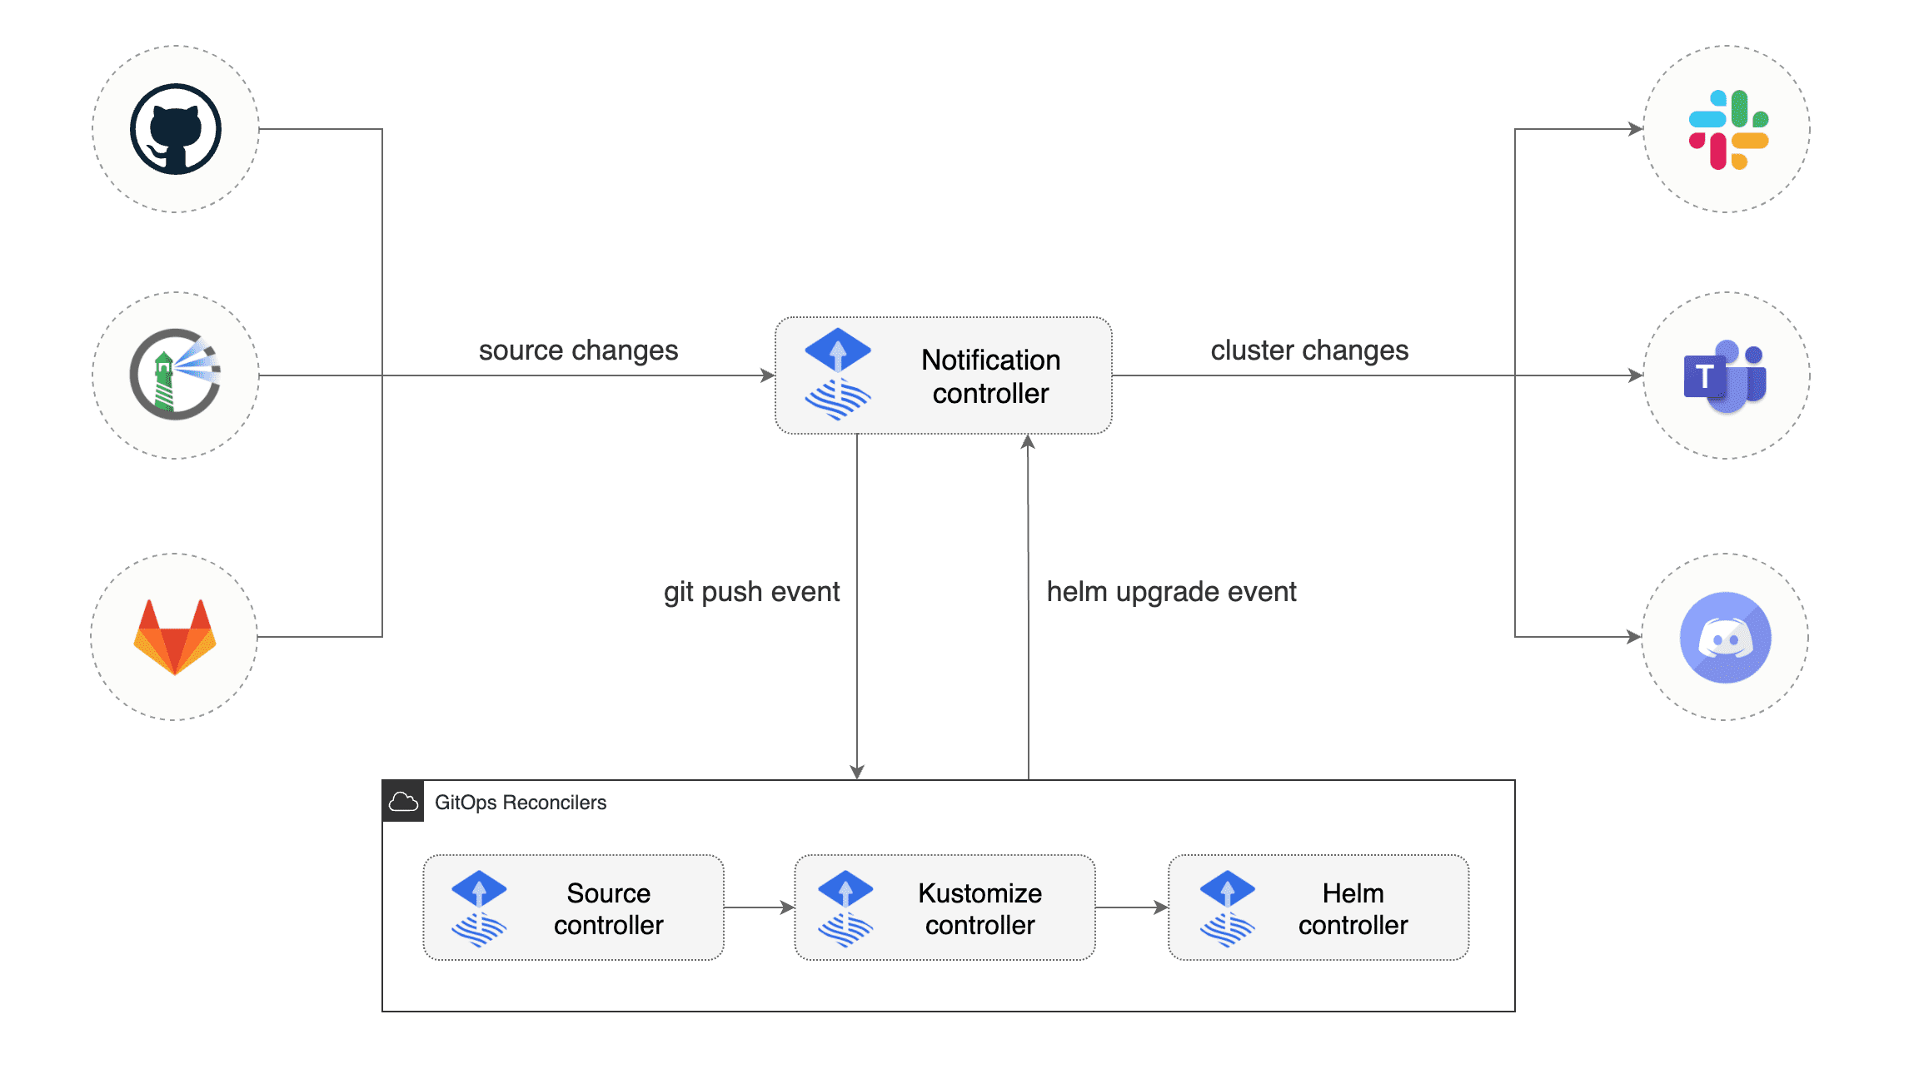
Notification Controller
The Notification Controller is a Kubernetes operator, specialized in handling inbound and outbound events

Slide 13
Notification Controller Features
The controller handles events coming from external systems (GitHub, GitLab, Bitbucket, Harbor, Jenkins, etc) and notifies the GitOps toolkit controllers about source changes.
The controller handles events emitted by the GitOps toolkit controllers (source, kustomize, helm) and dispatches them to external systems (Slack, Microsoft Teams, Discord, Rocker) based on event severity and involved objects.

Slide 14
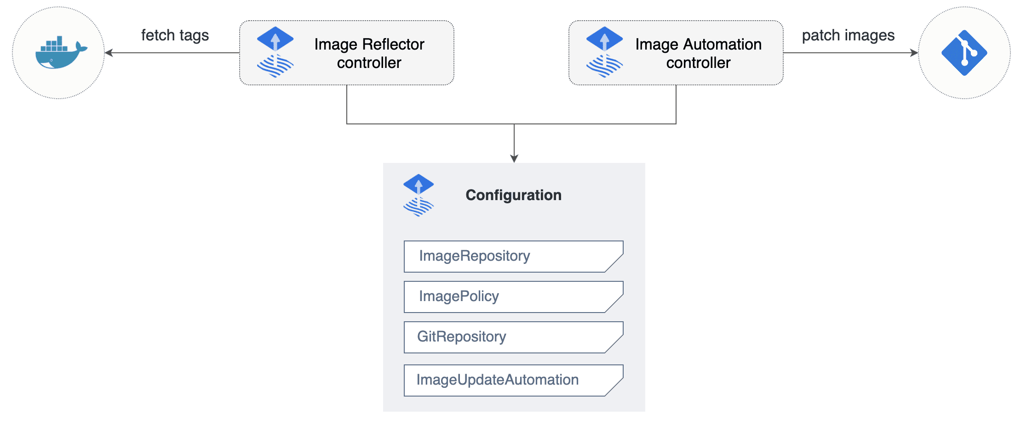
Image Automation Controllers
The image-reflector-controller and image-automation-controller work together to update a Git repository when new container images are available.
The image-reflector-controller scans image repositories and reflects the image metadata in Kubernetes resources.
The image-automation-controller updates YAML files based on the latest images scanned, and commits the changes to a given Git repository.

Slide 15
Pros & Cons
Pros:
Declarative Approach: FluxCD provides a declarative approach to application delivery and operations, which helps to manage deployments in a more predictable and manageable way
Synchronization: It helps in synchronizing the state of your cluster with the desired state defined in Git repositories.
Automated Deployments: FluxCD automates deployments, which reduces manual intervention and the risk of human error.
Rollbacks: If a deployment fails, FluxCD can roll back to a previous working state, which is automatically done based on Git history.
Cons:
Learning Curve: FluxCD has a steep learning curve, especially for those who are new to the concept of GitOpsComplexity: The tool can be complex to set up and configure correctly.
Debugging: Debugging issues can be challenging with FluxCD, especially when the desired state in Git is not in sync with what's running in the cluster

Slide 16
Demo
Covering the following examples:
Simple flux sync
Sample nginx deployment – standard k8s resources
Sample HelmRelease deployment – custom Flux resources
Kustomization with a patch

